Slide 1

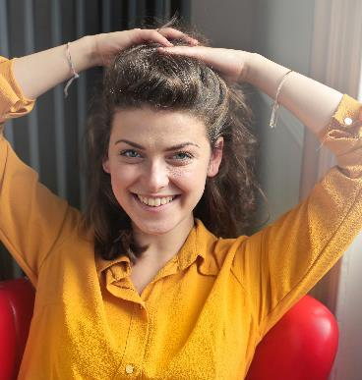
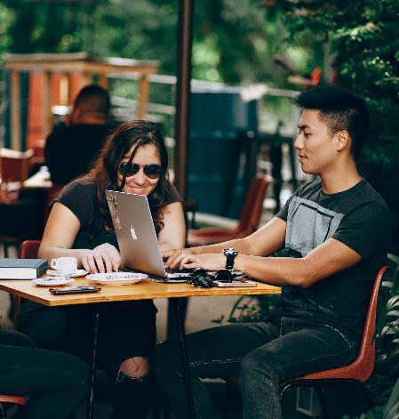

Worldwide Happiness Score between 2019 & 2020
By:
Georgina Guzman
Harpreet kaur
Paola Vázquez

Slide 2


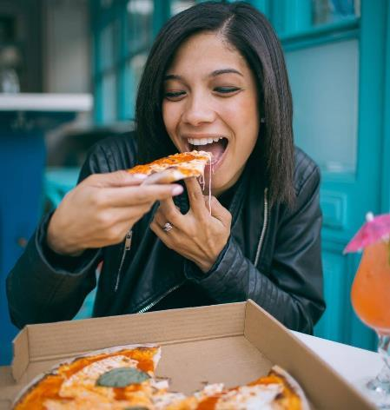
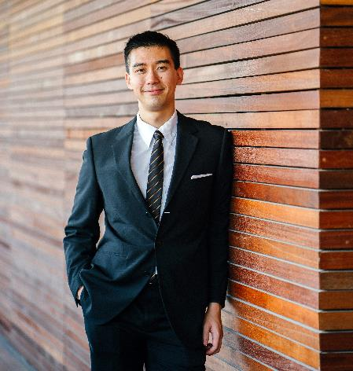
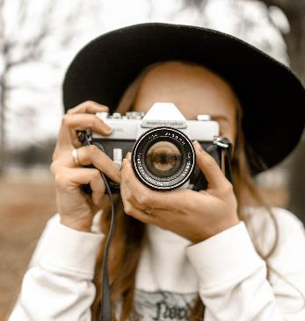
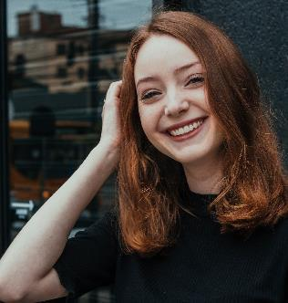
Diapositiva 2
2019,what a great year!
Going out to eat
Going to a workplace
Selfies everywhere
Going out

Slide 3

Imagen de gran tamaño
“2020 surprise me!”

Slide 4
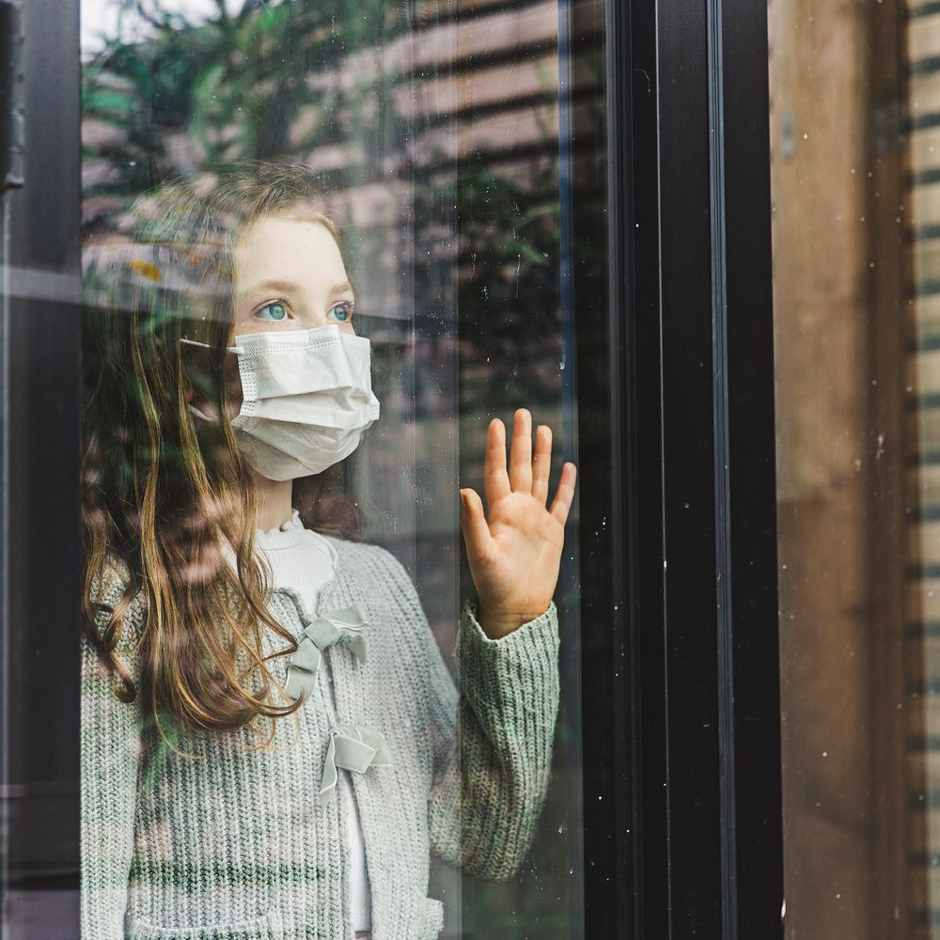
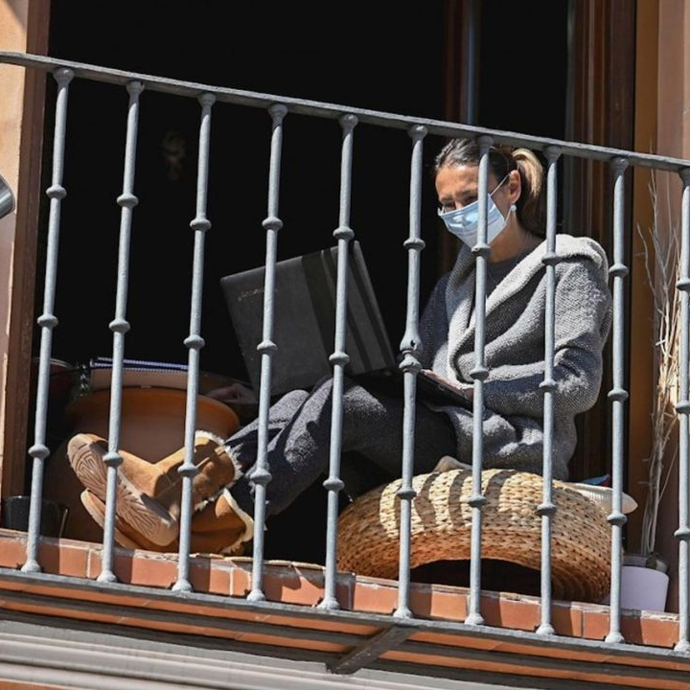
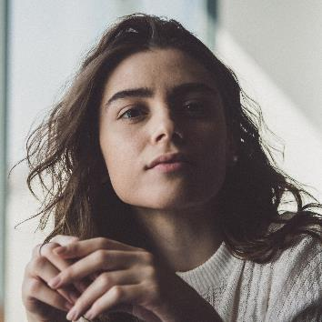


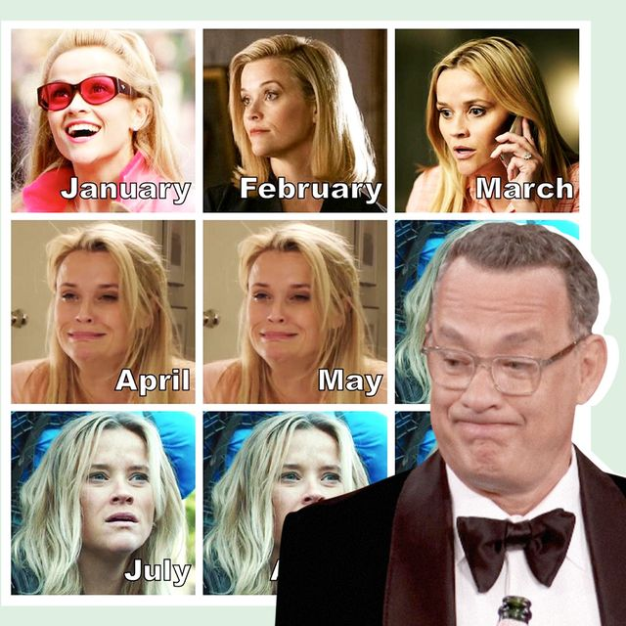

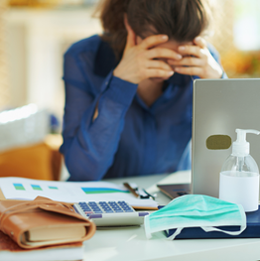
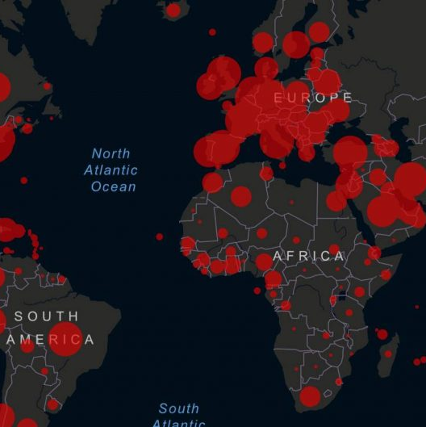
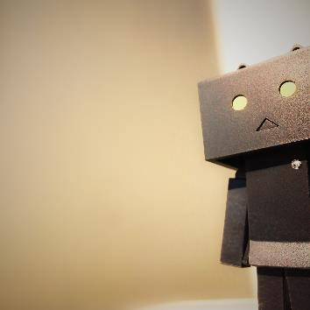
2020 resume
When can they go back to school?
Stop surprising me 2020!

Slide 5
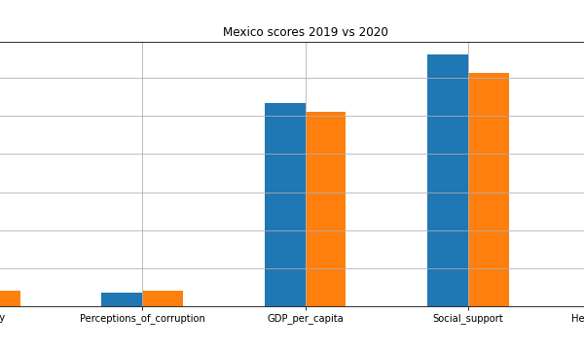
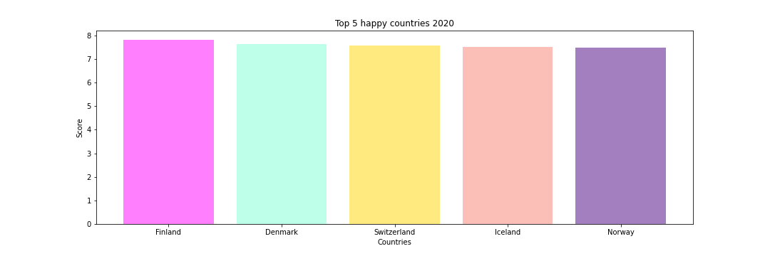
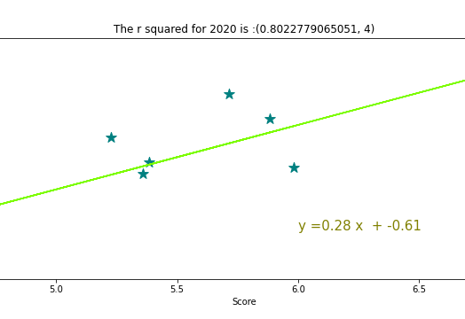
Our conclusions
Gama team

Slide 6
Resources
Data we analize
https://www.kaggle.com/mathurinache/world-happiness-report
Google API Keys
https://cloud.google.com/
Google images search
https://www.google.com/search?q=2020+covid&safe=active&bih=600&biw=1366&rlz=1C1CHBF_esMX817MX817&hl=en&sxsrf=ALeKk02zBztm0RydryhYoiq_JsNXEQG1LA:1604243696792&source=lnms&tbm=isch&sa=X&ved=2ahUKEwiToLi90eHsAhVVbc0KHRWiAnMQ_AUoAXoECCAQAw
How to make more pretty our graphs
https://matplotlib.org/
Pandas concepts
https://www.dataquest.io/blog/pandas-cheat-sheet/

